Slide 1
Retrieval
Retrieving top k relevant chunks from the vector database.

Slide 2
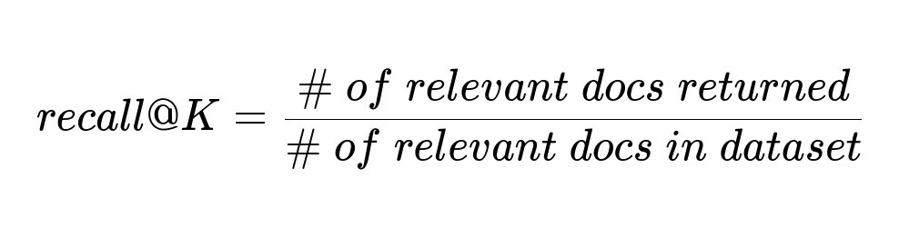
Retrieval Recall

Slide 3
Retrieval
But why should we retrieve top k document ?
Why cant we pass the entire document as the context ?

Slide 4
Retrieval
Each llm has a context window. If we pass the collection of entire documents, then the total number of tokens will exceed context window.
Hold on ! GPT has a larger context window. We should be able to pass the entire collection in 32K context.

Slide 5
LLM Recall
Its the ability of LLM to find the information from the text placed within the context.

Slide 6
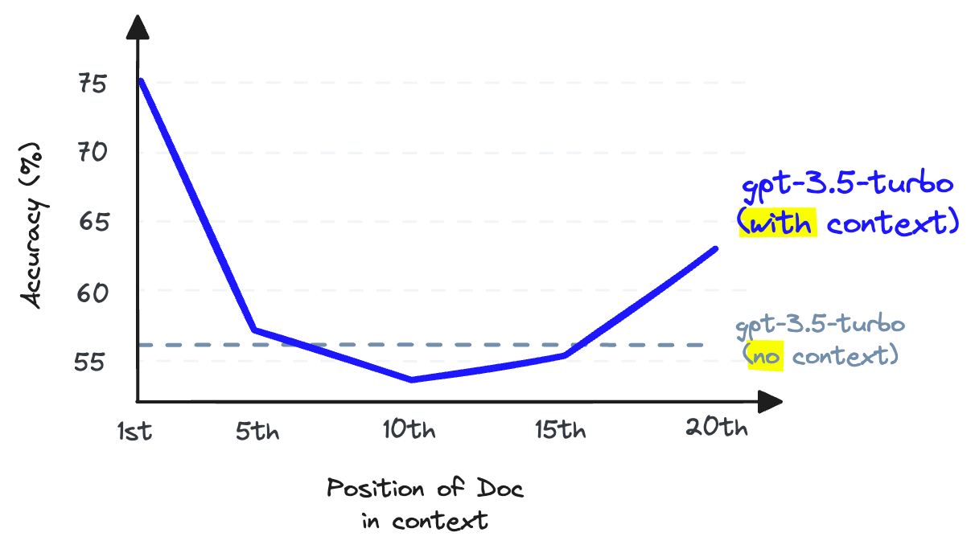

Slide 7
Solution
Increasing the K value will increase the retrieval recall , but at the same time, it will reduce the LLM recall
The solution is to maximize the retrieval recall by plenty of documents (say K=25) and maximize the LLM recall by the number of documents that get into LLM

Slide 8
Reranking

Slide 9
Example
Imagine we have a corpus of 5k documents. Given an input query we need to find top k relevant chunks (K=3).
What if the relevant chunks are 1, 5, 10. If we use only the retrieval, we will be missing the chunk 5 and 10.

Slide 10
Hold On !
If re-ranking is very accurate in finding the relevant chunks, then we do we even need ranking ?
Because, re-ranking is accurate but toooooooooooooooooo slow

Slide 11
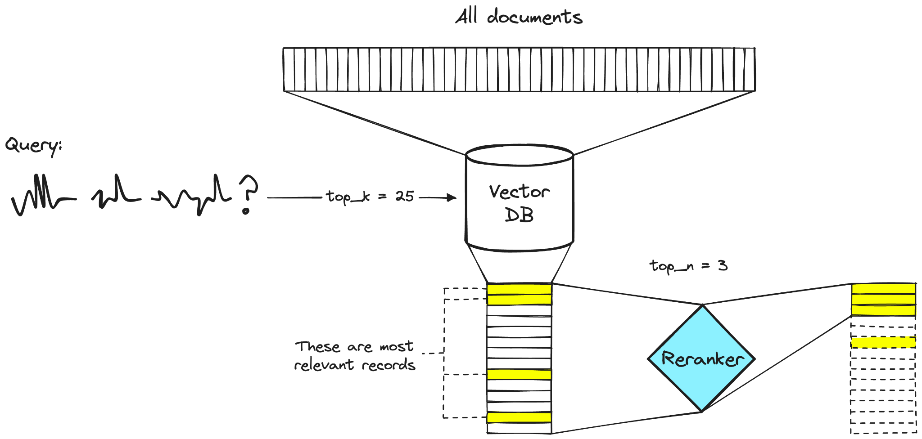

Slide 12
Are BERT and SBERT identical ?

Slide 13


Slide 14
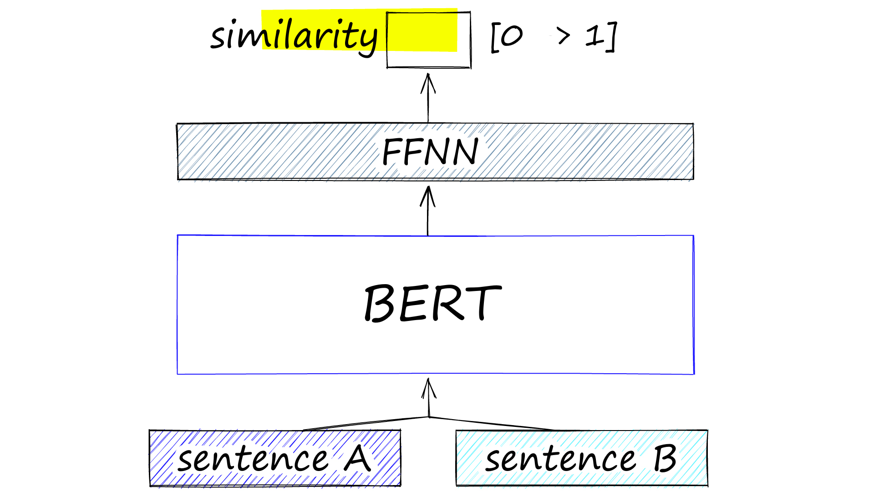

Slide 15
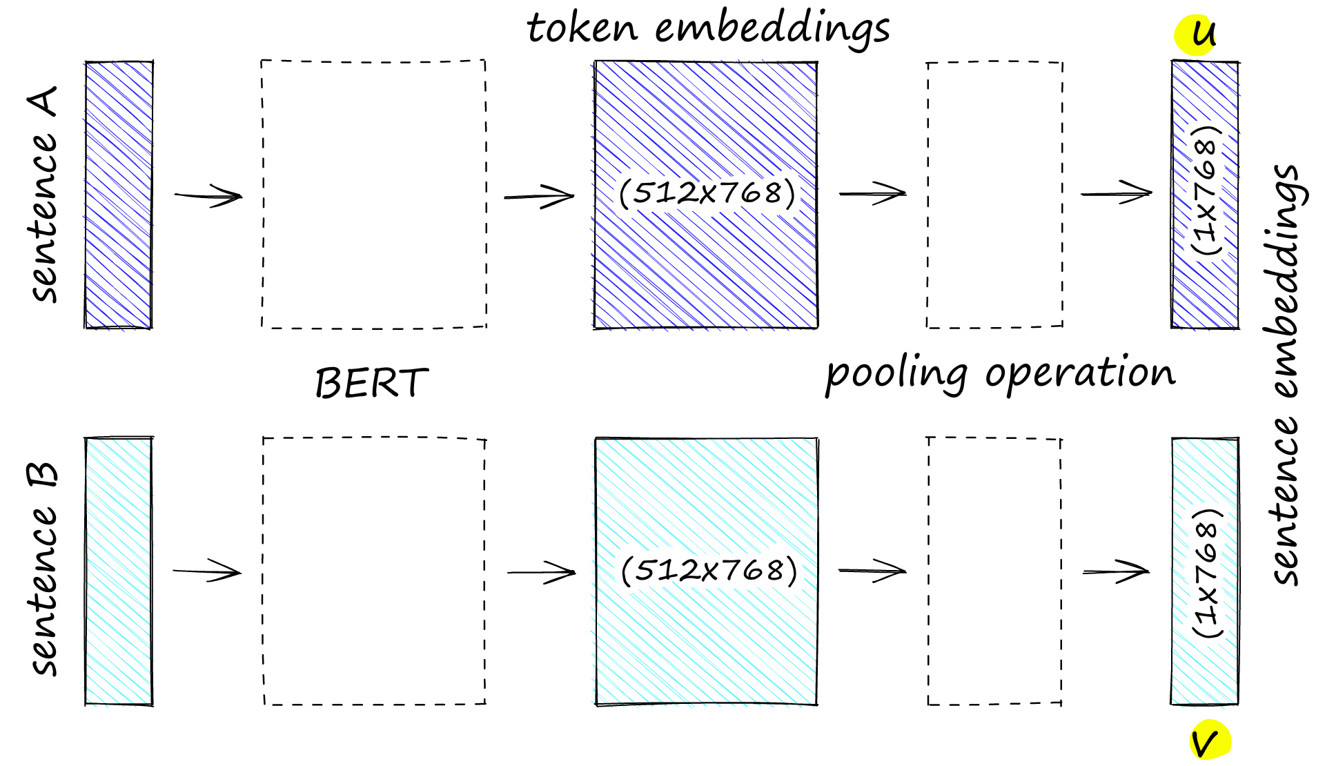

Slide 16
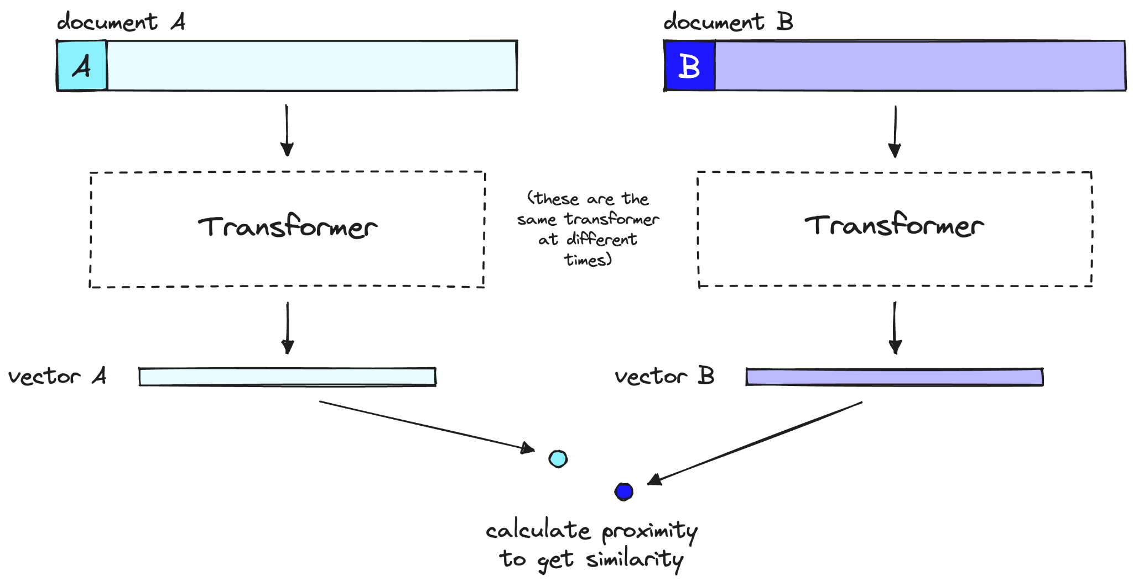
Bi Encoder

Slide 17
Bi Encoder
Frontlines all the heavy transformer computations (indexing)
When user gives a query, we already have the vectors of all the sentences
We just need to perform only one embedding and find the similarity score against all other vectors

Slide 18
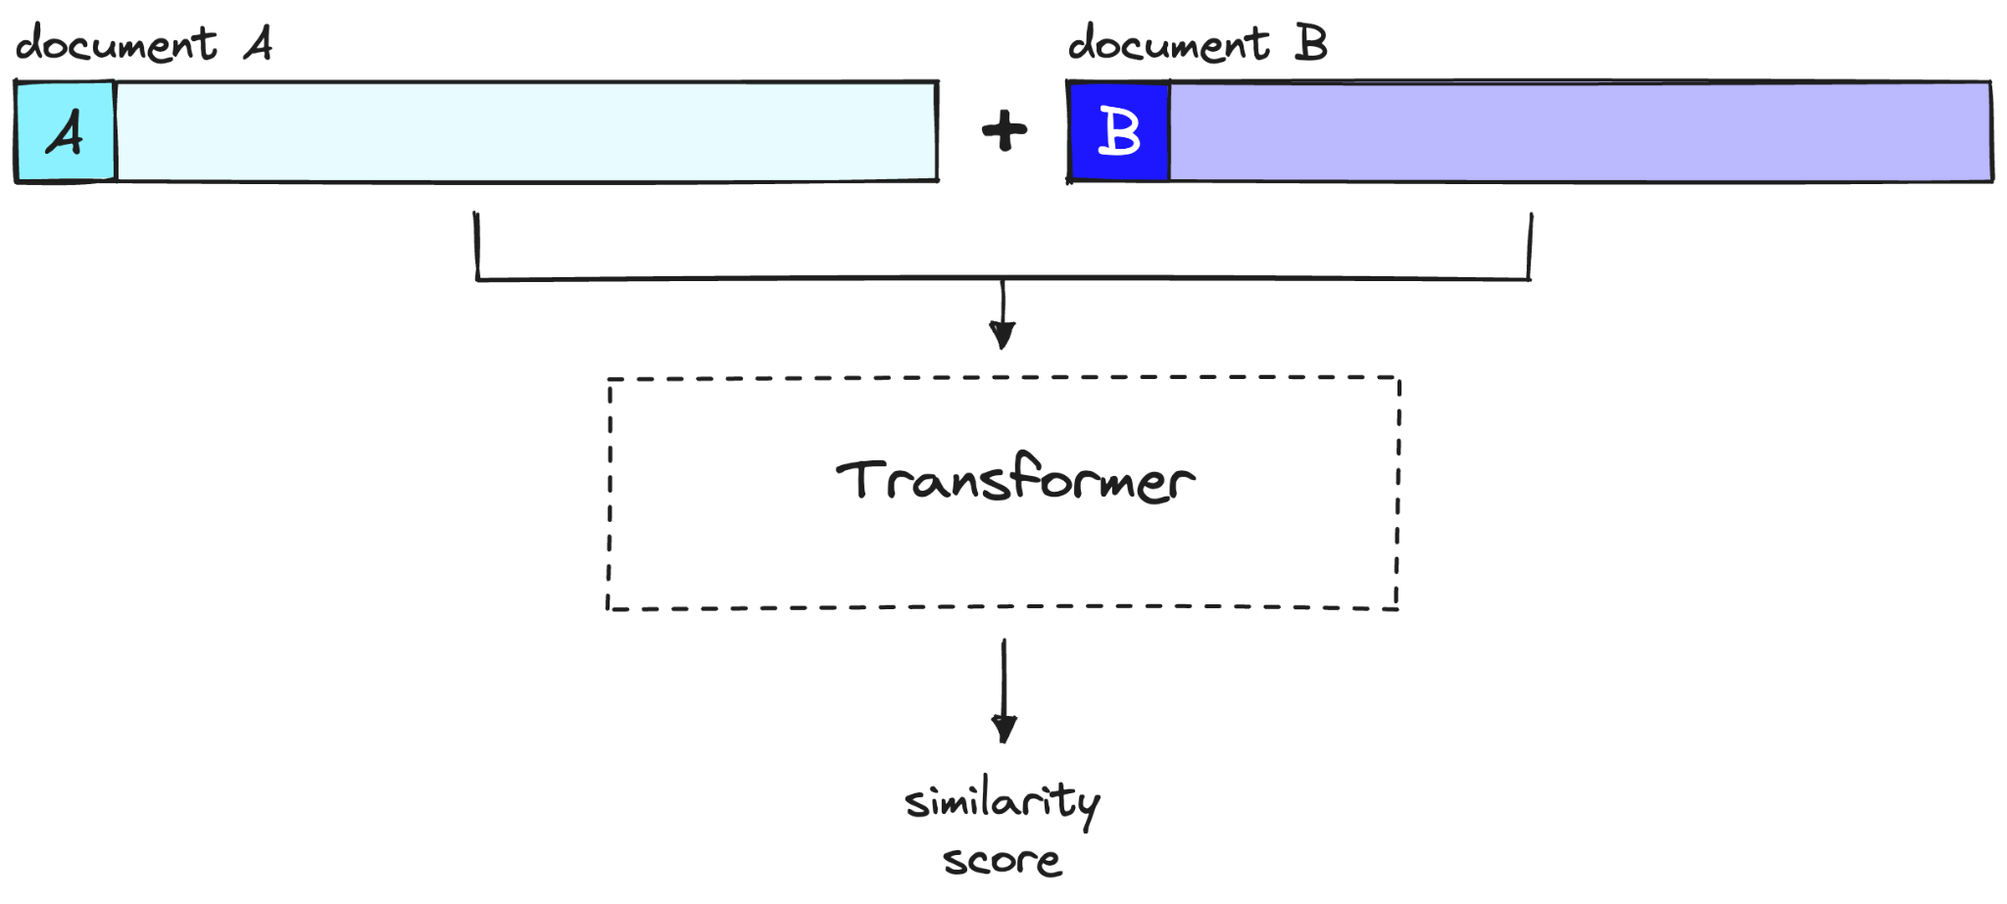
Cross Encoder

Slide 19
Cross Encoder
We are not pre-computing anything
Instead we are feeding our query and a single other document into the transformer, running a transformer whole inference step, outputting a single similarity score

